Slide 1
Employee Data Analysis using Excel
STUDENT NAME:ASHWIN KUMAR.S
REGISTER NO:122203368
D88EB3B831E8CA397C04A5101F2B34EF
DEPARTMENT:BCOM.(CS)
COLLEGE:ST.THOMAS COLLEGE OF ARTS AND SCIENCE

Slide 2
PROJECT TITLE
VISUALIZING EMPLOYEE
ATTENDANCE TRENDS WITH
EXCEL CHARTS

Slide 3


AGENDA
Problem Statement
Project Overview
End Users
Our Solution and Proposition
Dataset Description
Modelling Approach
Results and Discussion
Conclusion
3/21/2024 Annual Review

Slide 4

PROBLEM STATEMENT
i) CONTEXT: Employee is a critical aspect of workforce management , impacting productivity,
operational efficiency, and overall organizational performance.
ii) Issue: Current method for tracking and analysing attendance data are insufficient, leading
to challenging in identifying trends, predicting absenteeism, and making informed decisions.
iii) OBJECTIVE: To develop a comprehensive approach of visualizing attendance trends that will.
*Identify patterns and anomalies in employee attendance.
*Support data-driven decision-making for better resource allocation.
*Enhance understanding of absenteeism impacts on operational efficiency.

Slide 5

PROJECT OVERVIEW
i) PROJECT PURPOSE: To enhance the understanding of employee attendance patterns through
effective visualization techniques
ii) Key Components: Gather historical and real-time attendance data from various sources such
as time-tracking systems and HR records.
iii) BENEFITS: Visual representations make it easier to spot trends and outliers.
iv) PROJECT PHASES
Phase 1: DATA COLLECTION
* Collect and integrate attendance data from relevant sources.
Phase 2: ANALUSIS AND DESIGN
* Analyze data and design appropriate visualization formats.
Phase 3: IMPLEMENTATION
* Develop and deploy visualizations through chosen tools and platforms.
Phase 4: EVAKUATION AND FEEDBACK
* Assess the effectiveness of visualizations and gather user feedback for improvements.

Slide 6

WHO ARE THE END USERS?
i) HR MANAGER.
ii) TEAM LEADER/SUPERVISORS.
iii) SENIOR MANAGEMENT.
iv) PAYROLL ADMINISTRATORS.
v) DATA ANALYSTS.
vi) EMPLOYEE RELATIONS SPECIALISTS.
vii) COMPLIANCE OFFICERS.

Slide 7

OUR SOLUTION AND ITS VALUE PROPOSITION
i) ENHANCED DECISION-MARKING: Provides actionable insights into attendance actionable
insights into attendance trends, helping management make informed decisions on staffing
and resource allocation.
ii) INCREASED PRODUCTIVITY: Identifies patterns of absenteeism and tardiness, enabling
strategies to improve punctuality and overall productivity.
iii) COST EFFICIENCY: Helps in managing labor costs by optimizing staffing levels based on
predicted attendance patterns.
iv) EMPLOYEE ENGAGEMENT: Offers a transparent view of attendance, fostering accountability
and engagement among employees.
v) COMPLIANCE AND REPORTING: Ensures accurate tracking of attendance for compliance
with labor laws and supports comprehensive reporting requirements.

Slide 8
Dataset Description
i) TIME SERIES GRAPH: Plot the number of absences or attendance over time (e .g ., daily, weekly,
monthly) to identify trends and patterns.
ii) HEAT MAP: Display attendance data across days of the week and months of the year to spot
peak absent times.
iii) BAR CHART: Compare attendance metrics (e .g ., average number of days present or absent)
across different departments or shifts.
iv) PIE CHARTS: Show the proportion of different attendance statuses (e .g ., present, absent, on
leave) fir a specific period.
v) LINE CHART: Track the attendance trend of individual employees over time to identify consistent
patterns or irregularities.
vi) STOCK AREA CHART: Visualize how attendance statuses (present, absent, on leave) change over
time foe different departments or shifts.
vii) SCATTER PLOT: Analyze the relationship better attendance and other variables such as
department or shift.

Slide 9
THE "WOW" IN OUR SOLUTION
Predictive analytics: Integrating predictive methods to forecast future attendance trends based on historical data, giving managers a proactive Approach to workplace planning.Automated alerts: the tool can be set up to send automated alerts for critical employee attendance issues, ensuring that managers are immediately notified when attention needed.
3/21/2024 Annual Review
9

Slide 10
Modeling
In the "Employee Performance Analysis Using Excel" project, the modelling phase involves setting up the Excel workbook with various tools and techniques to analyse and visualize the data effectively.Here's how each component will be used:
Data Filtering Purpose: To sort and refine the data to focus on specific criteria, such as department, date range, or individual employee performance.
Implementation: Excel's filtering feature will be applied to datasets, allowing users to easily narrow down the data to view only the relevant information. For example, filtering by department or by performance rating.
2. Pivot Tables Purpose: To summarize and analyze large datasets by grouping and aggregating data based on different performance metrics. Implementation: Pivot tables will be used to dynamically calculate and display key performance indicators (KPIs) such as average task completion time, total hours worked, or percentage of targets met. This will allow users to view performance metrics by different categories, like employee, team, or month.
10

Slide 11
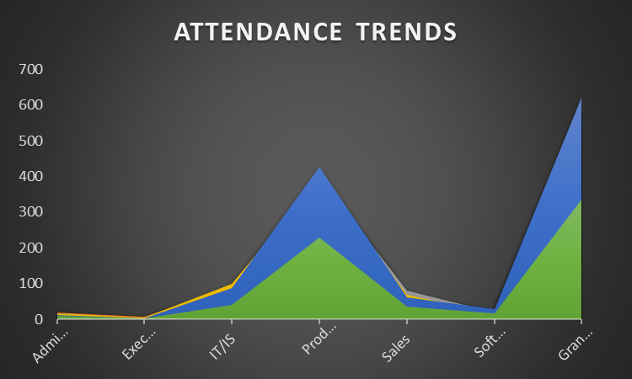
RESULTS
11

Slide 12
conclusion
1.Visualizing employee attendance trends provides a powerful tool for enhancing organizational efficiency and decision-making.
2. By transforming raw attendance data into clear, actionable insights, your solution help managers identify patterns, optimize staffing, and improve overall workforce management.
3.This nor only streamlines reporting and boosts operational effectiveness but also fosters a more responsive and data-driven approach to handling employee attendance.
4.As a result, organizations can better align their resources with actual needs, ultimately supporting a more productive and engaged workforce.

